Slide 1
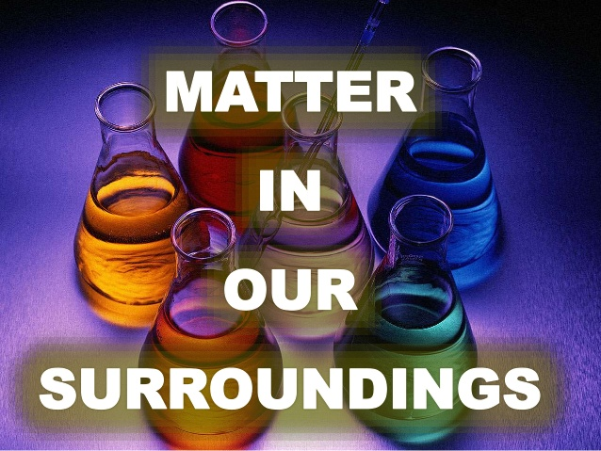

Slide 2


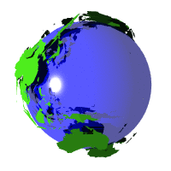
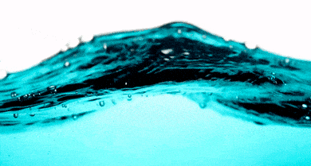

MATTER IN OUR SURROUNDINGS
Every Indian philosophers classified matter in the form of five basic elements .

Slide 3
MATTER IN OUR SURROUNDINGS
Anything that has mass and occupy space(VOLUME).
MATTER
They are made up of particles.
We can see, touch , taste , feel them.

Slide 4

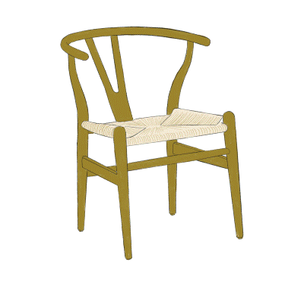
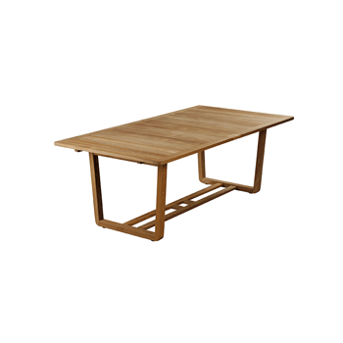


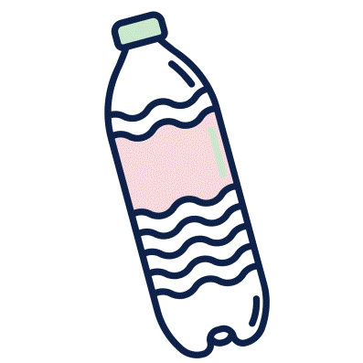


MATTER IN OUR SURROUNDINGS

Slide 5
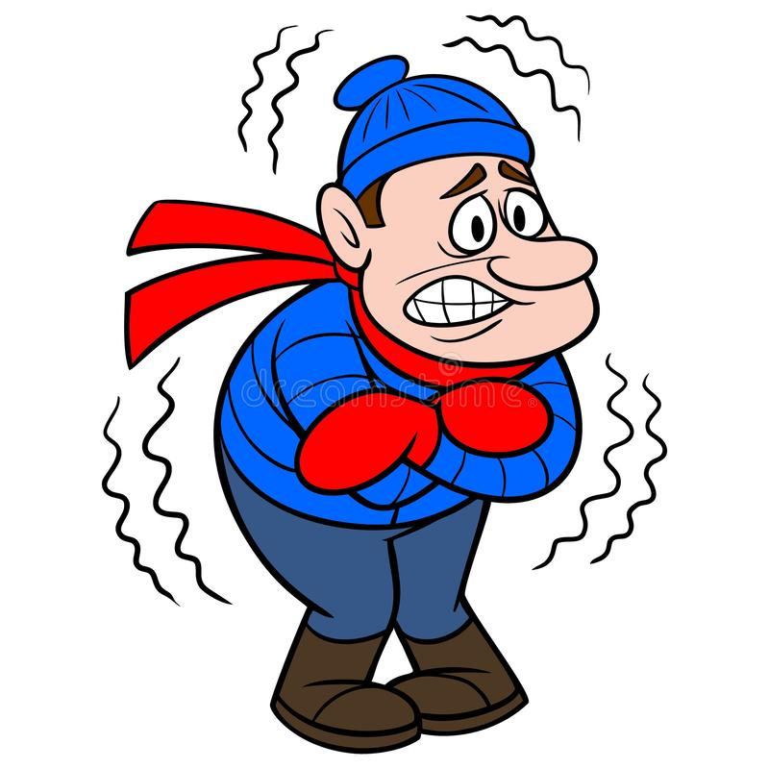




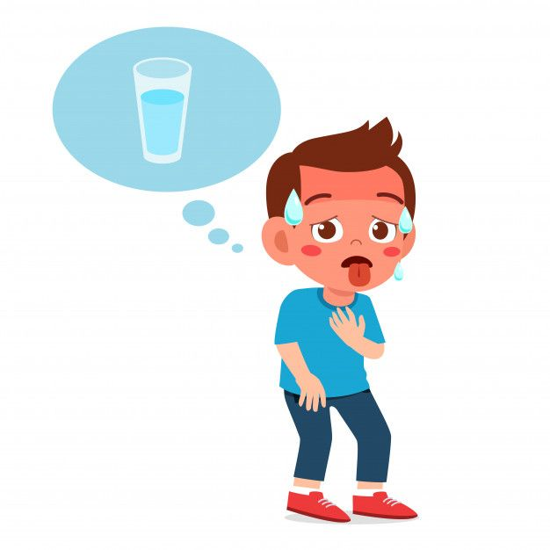
MATTER IN OUR SURROUNDINGS

Slide 6
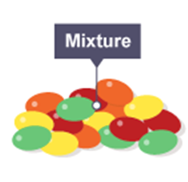
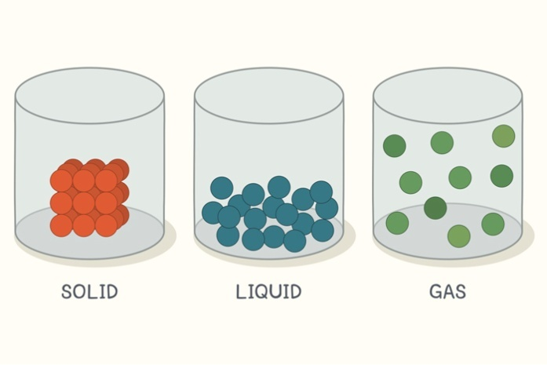
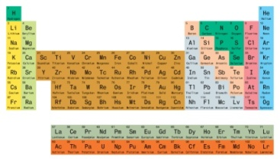
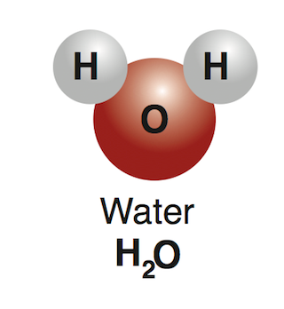
MATTER IN OUR SURROUNDINGS
CLASSIFICATION OF MATTER
PHYSICAL CLASSIFICATION
CHEMICAL CLASSIFICATION

Slide 7
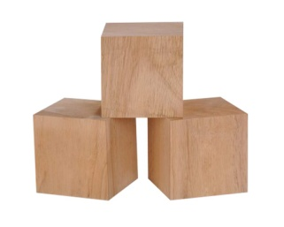
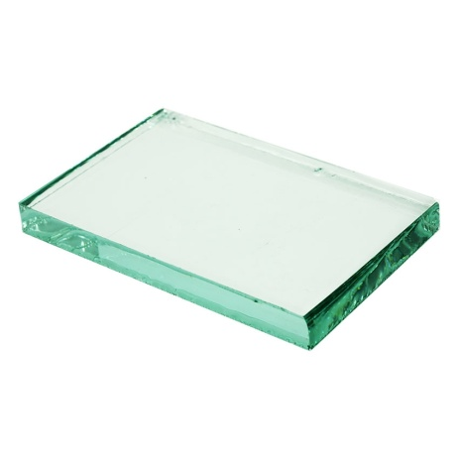
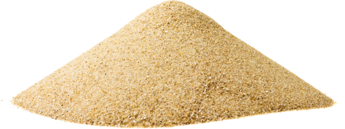
MATTER IN OUR SURROUNDINGS
PHYSICAL NATURE OF MATTER
Continuous nature
Particulate nature

Slide 8
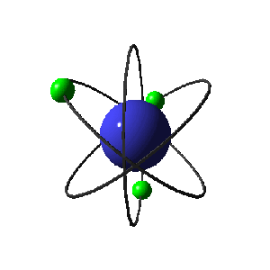
MATTER IN OUR SURROUNDINGS
Particles which make up matter are atoms or
molecules.
However, these particles differ from one kind of
matter to the other.

Slide 9
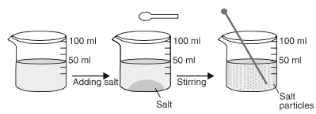
MATTER IN OUR SURROUNDINGS
Matter is made up of particles
ACTIVITY
To show the particle nature of matter.

Slide 10
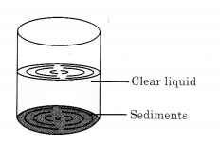
MATTER IN OUR SURROUNDINGS
NOW ANSWER
What happened to the common salt initially?

Slide 11
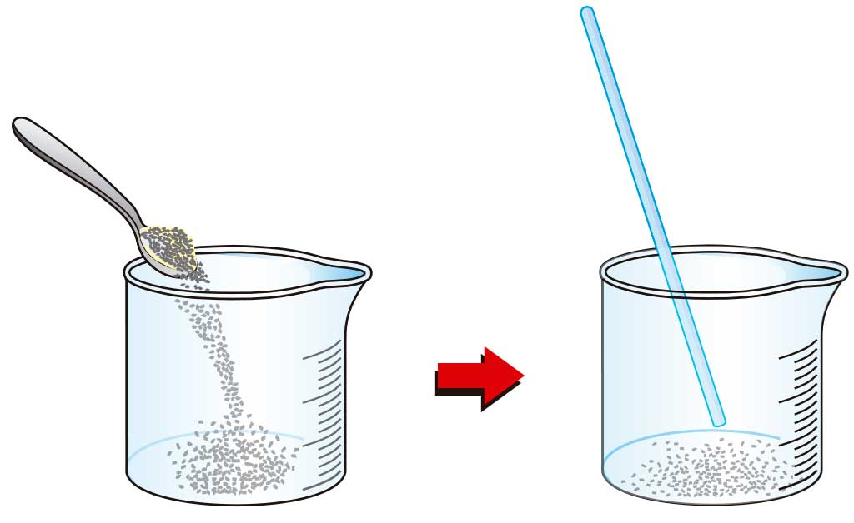
MATTER IN OUR SURROUNDINGS
NOW ANSWER
(B) What happened to the common salt on stirring?

Slide 12
MATTER IN OUR SURROUNDINGS
NOW ANSWER
(C) What happened to the level of water in the beaker after the
activity is over?

Slide 13
MATTER IN OUR SURROUNDINGS
NOW ANSWER
(D) Where does the common salt disappear?

Slide 14
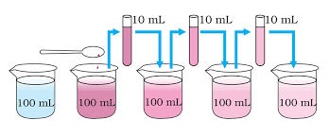
MATTER IN OUR SURROUNDINGS
Size of particles
ACTIVITY
To show that the constituent particle of matter are very small.

Slide 15
MATTER IN OUR SURROUNDINGS
OBSERVATION
Only a few crystals of potassium permanganate can colour a large
volume of water.
CONCLUSION
There must be millions of tiny particles in just one crystal of
potassium permanganate which keep on dividing themselves into
smaller and smaller particles with each dilution there by making
the colour lighter and lighter.

Slide 16
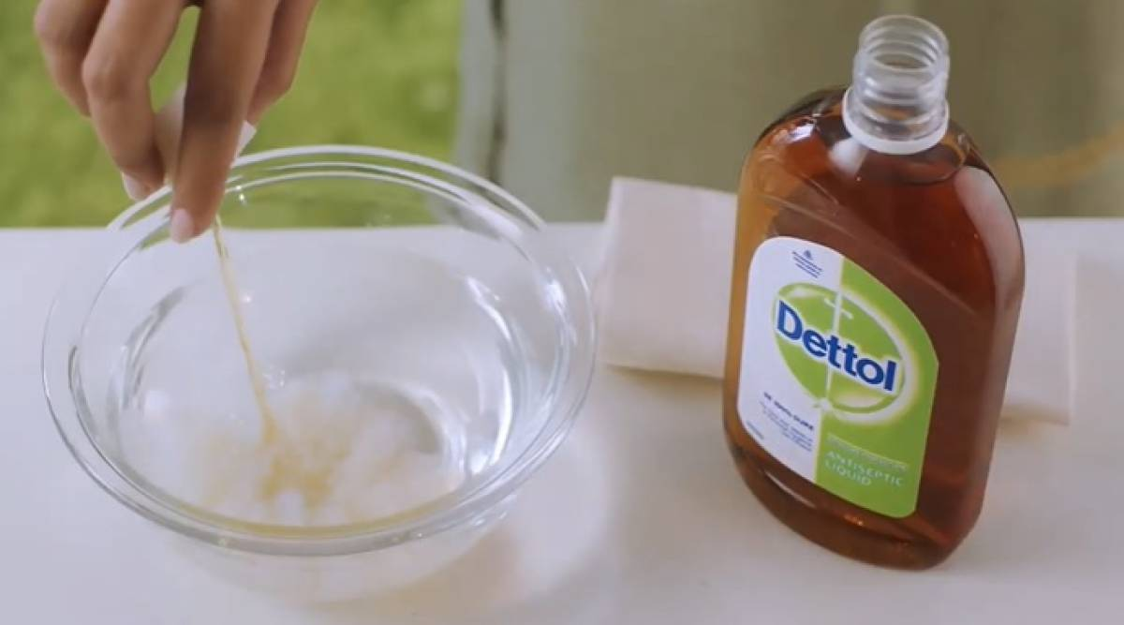
MATTER IN OUR SURROUNDINGS

Slide 17
MATTER IN OUR SURROUNDINGS
Characteristics of Particles of Matter
(1) Particles of matter have space between them
(2) Particles of matter are continuously moving
(3) Particles of matter attract each other

Slide 18
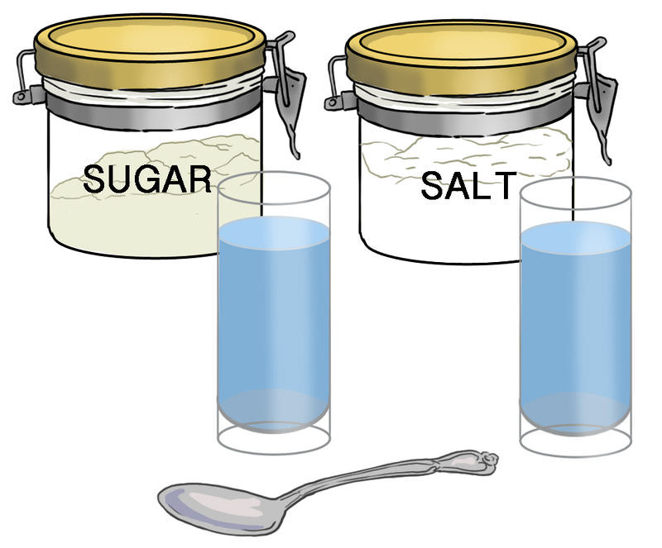
MATTER IN OUR SURROUNDINGS
(1) Particles of matter have space between them

Slide 19
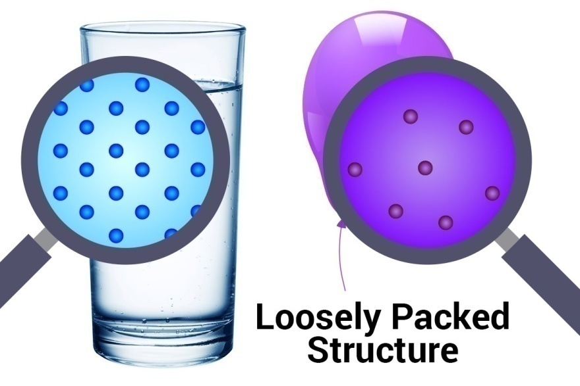
MATTER IN OUR SURROUNDINGS
Is there any change in the volume?

Slide 20


MATTER IN OUR SURROUNDINGS
Examples of daily life where we observe that particles of one type of matter get into the spaces between particles of other.

Slide 21
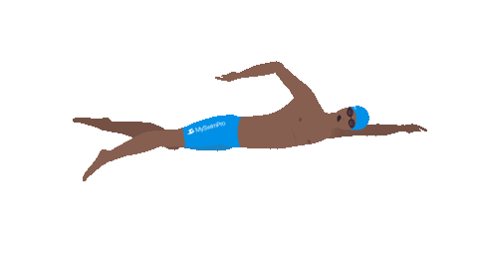
MATTER IN OUR SURROUNDINGS
Q. The diver is able to cut through water in a swimming pool. Why ?

Slide 22
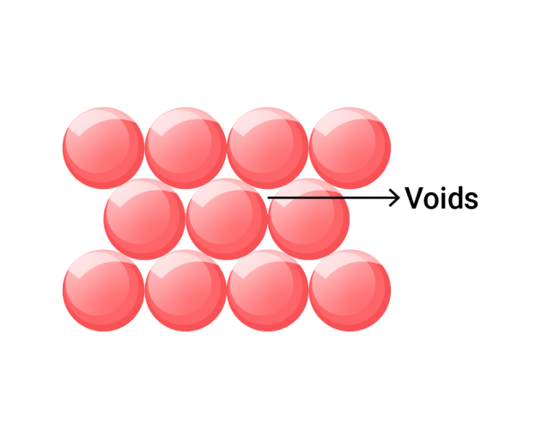
MATTER IN OUR SURROUNDINGS
(ii) Particles of matter are continuously moving
Matter is made up of very small particles and these are separated from one another by empty spaces or voids also called as interparticle space.

Slide 23
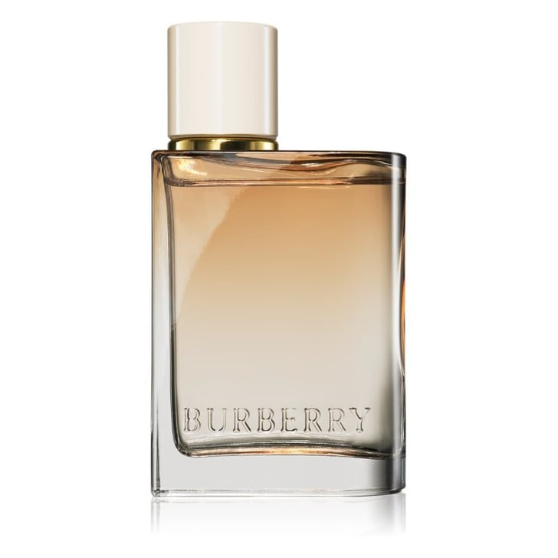
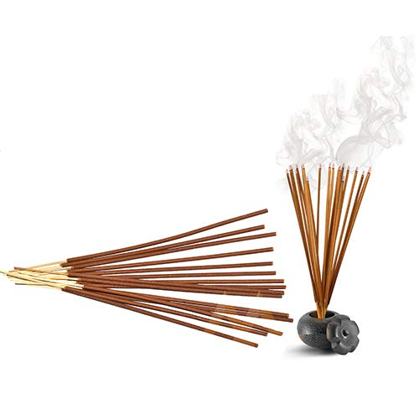
MATTER IN OUR SURROUNDINGS
ACTIVITY
To prove that the particles of matter are in state of continuous motion.

Slide 24
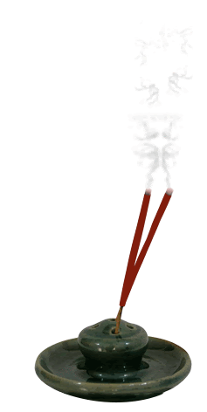
MATTER IN OUR SURROUNDINGS
NOW ANSWER
Q. Why can you smell the perfume of incense stick when you were close to the stick?

Slide 25

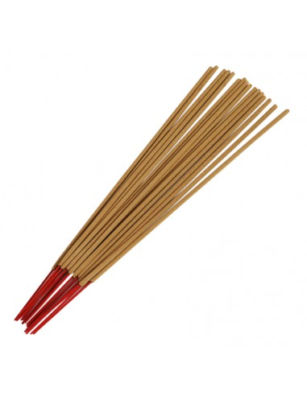

MATTER IN OUR SURROUNDINGS
NOW ANSWER
Q. Why can you not smell the perfume at a short distance when the incense stick is not lighted?

Slide 26
MATTER IN OUR SURROUNDINGS
NOW ANSWER
Why does the smell of perfume of the incense stick fill the whole
room in few minutes ,when lighted ?

Slide 27
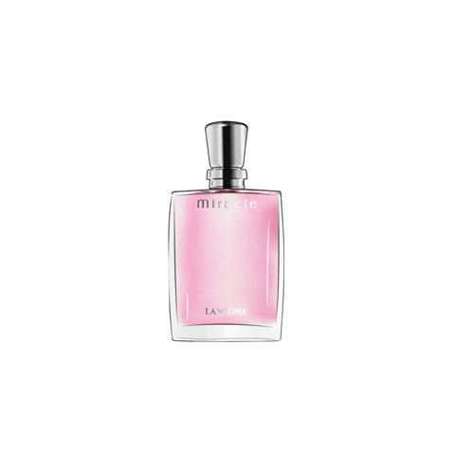
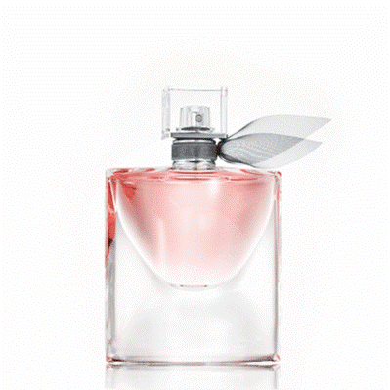
MATTER IN OUR SURROUNDINGS
Q. We can get the smell of perfume sitting several meters away . Why?
Perfume contains volatile solvent which carries pleasant smelling vapours.
They diffuse quite fast and can reach to people sitting several meters away.

Slide 28
MATTER IN OUR SURROUNDINGS
CONCLUSION
a. Particles of matter are in continuous state of motion and hence have some energy .
b. When the temperature of matter rises particles move faster.

Slide 29
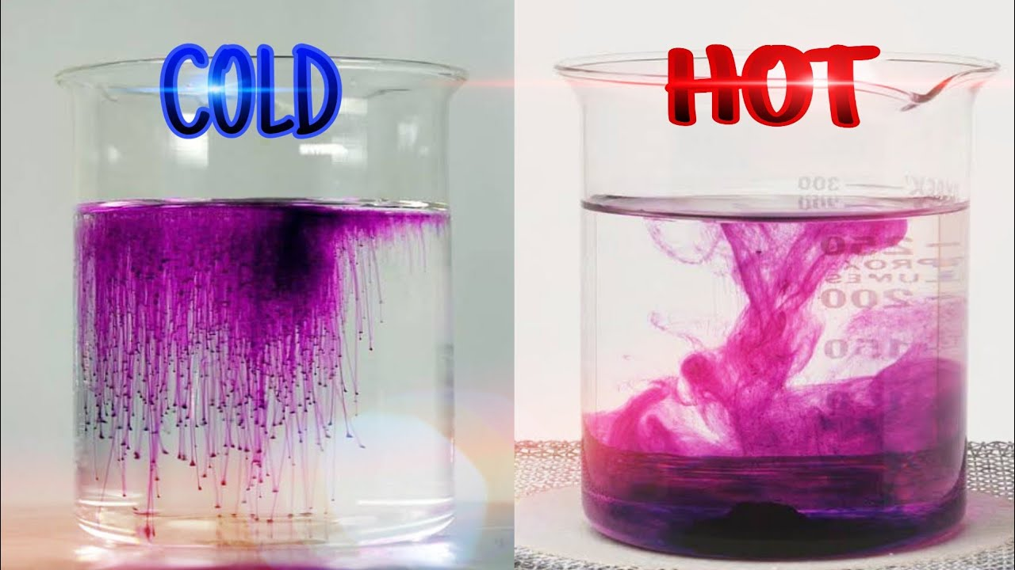
MATTER IN OUR SURROUNDINGS
ACTIVITY
To demonstrate that the kinetic energy of particles increases with increase in temperature .

Slide 30
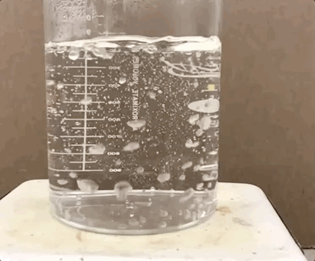
MATTER IN OUR SURROUNDINGS
CONCLUSION
The particles of matter possess motion and that the kinetic energy of the particles increases with increase in temperature.

Slide 31
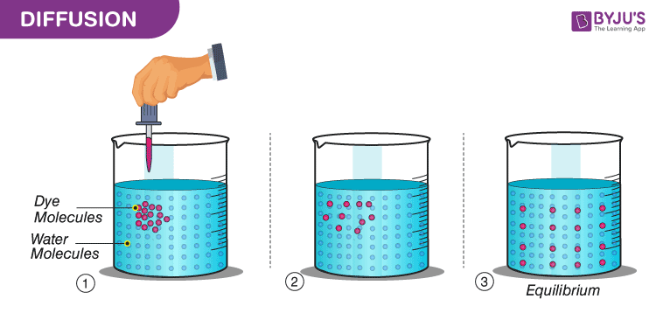
MATTER IN OUR SURROUNDINGS
AIM
To understand different rates of diffusion by different substances.

Slide 32
MATTER IN OUR SURROUNDINGS
Now Answer
Q. What do you observe immediately after adding the ink drop?
Q. What do you observe immediately after adding a drop of honey ?
Q. How many hours or days does it take for the colour of ink to spread evenly throughout the water ?

Slide 33
MATTER IN OUR SURROUNDINGS
CONCLUSION
Rate of diffusion depends upon the nature of substances.
More viscous substances which have particles with less kinetic
energy, takes more time to get diffused.

Slide 34
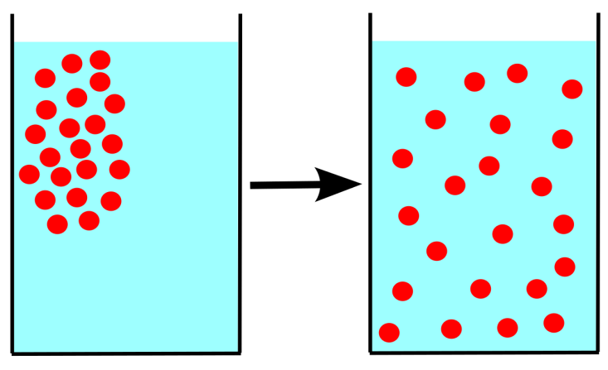
MATTER IN OUR SURROUNDINGS
“ This spontaneous intermixing of particles of two or more different substances is called diffusion”
The rate of diffusion becomes faster with increase in temperature because at higher temperature , the particles have more energy and hence move faster.

Slide 35
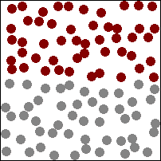
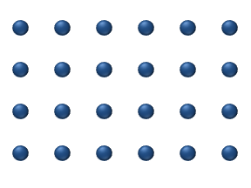
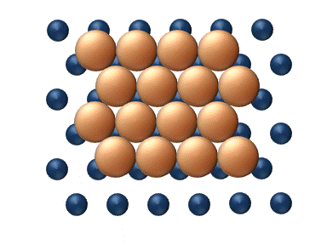
MATTER IN OUR SURROUNDINGS
Diffusion is ,
Fastest between two gases.
Slower between two different liquids or a solid and a liquid.
Slowest (or almost negligible) in case of two different solids.

Slide 36
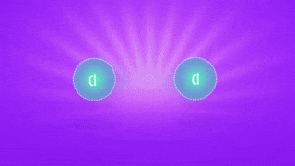
MATTER IN OUR SURROUNDINGS
(iii) Particles of matter attract each other
Why these particles are present together to form a continuous appearance of matter ?

Slide 37
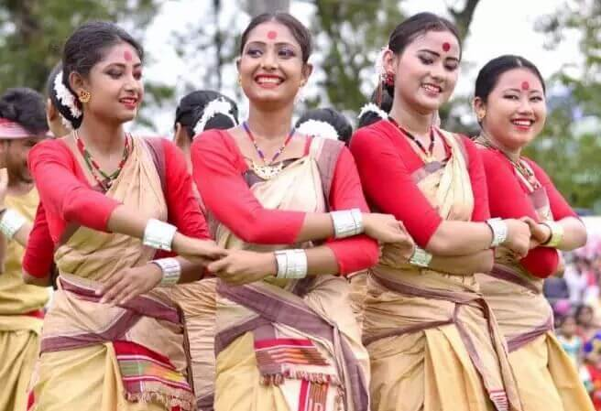
MATTER IN OUR SURROUNDINGS
ACTIVITY
To demonstrate the strength of attractive forces between particles of different kinds of matter .

Slide 38
MATTER IN OUR SURROUNDINGS
ACTIVITY
Q. Which group was easiest to break ? Why ?
Q. If we consider each student as a particle of matter, then in which group the particles held each other with the maximum force ?
CONCLUSION
Particles of matter attract to each other.

Slide 39
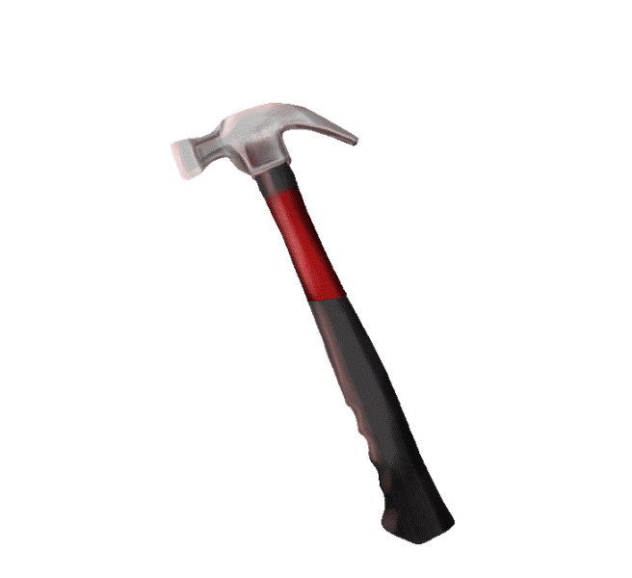
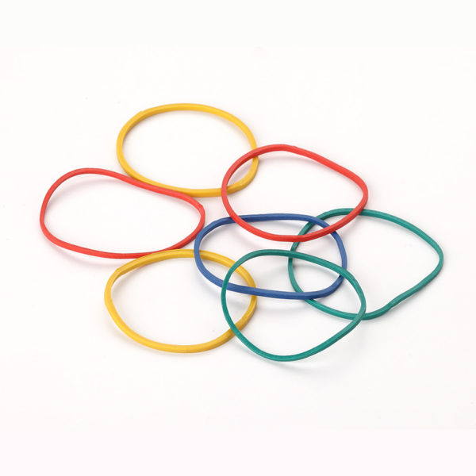
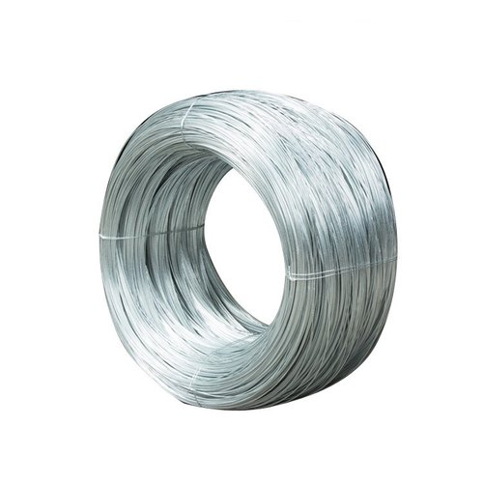

MATTER IN OUR SURROUNDINGS
ACTIVITY
To show that particles of different matter have different force of attraction .

Slide 40
MATTER IN OUR SURROUNDINGS
Q. In which of the above three substances do you think the particles are held together with greater force ?
Conclusion
This shows that different kind of matter possess different forces of attraction.

Slide 41
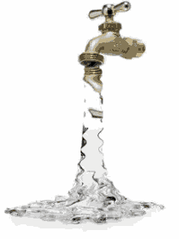
MATTER IN OUR SURROUNDINGS
ACTIVITY
To show that particles of matter attract each other.

Slide 42
MATTER IN OUR SURROUNDINGS
Conclusion

Slide 43

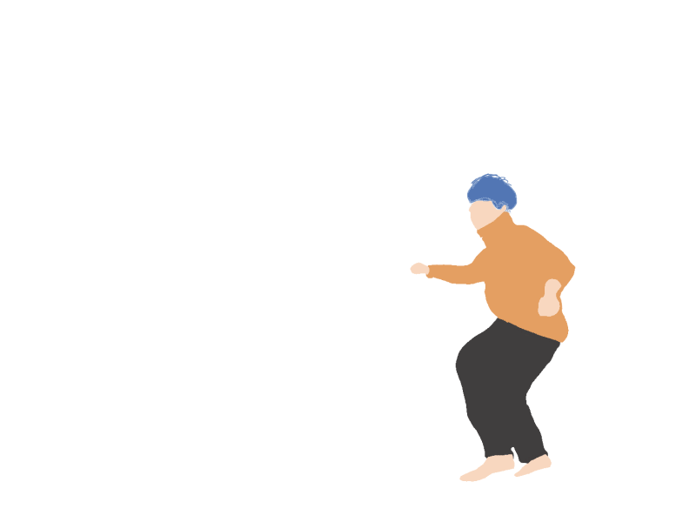
MATTER IN OUR SURROUNDINGS
Q. We can easily move our hand in the air but to do the same through a solid block of wood we need a karate expert. Why ?

Slide 44
MATTER IN OUR SURROUNDINGS
Q. Which of the following are matter?
Chair ,air , love , smell , hole , almonds , thoughts , cold , cold drink.

Slide 45
MATTER IN OUR SURROUNDINGS
STATES OF MATTER
SOLIDS
GAS
LIQUIDS

Slide 46
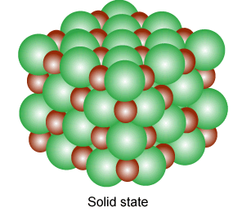
MATTER IN OUR SURROUNDINGS
THE SOLID STATE
Solids are known for their hardness and rigid nature.
CHARACTERISTICS OF THE SOLID STATE
(1) Solids have fixed shape

Slide 47
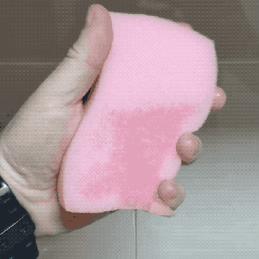
MATTER IN OUR SURROUNDINGS
(2) Some solids can change their shape

Slide 48
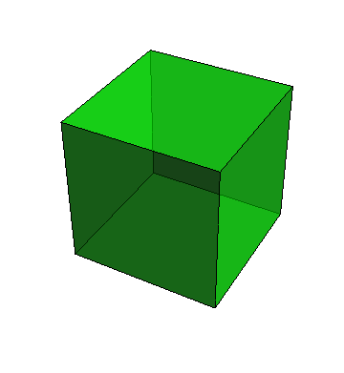
MATTER IN OUR SURROUNDINGS
(3) Solids keep their volume

Slide 49
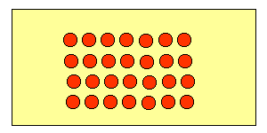
MATTER IN OUR SURROUNDINGS
(4) Solids can be hardly compressed on applying pressure.

Slide 50
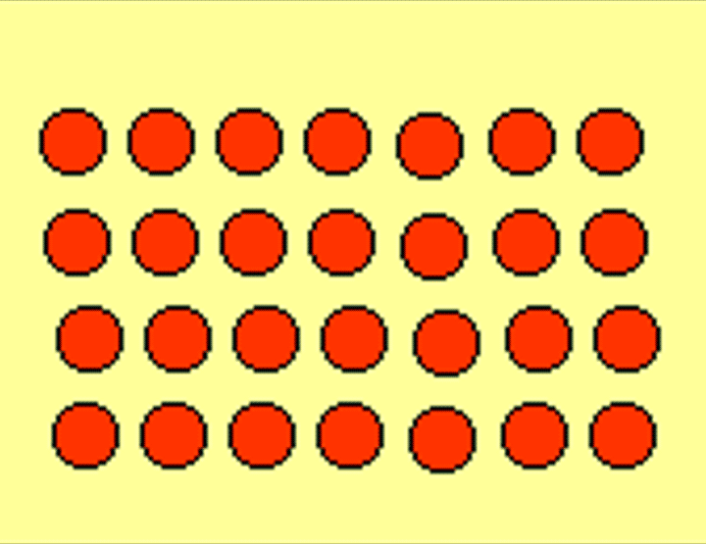
MATTER IN OUR SURROUNDINGS
(5) Solids have negligible kinetic energy of the particles.

Slide 51

MATTER IN OUR SURROUNDINGS
(6) Solids do not have the property of diffusion .

Slide 52

MATTER IN OUR SURROUNDINGS
Q. Why a wooden block should be called a solid ?

Slide 53

MATTER IN OUR SURROUNDINGS
Q. A rubber band undergoes a change in shape on stretching , still we called it a solid. Why ?

Slide 54




MATTER IN OUR SURROUNDINGS
ACTIVITY
To study the properties of solids.

Slide 55

MATTER IN OUR SURROUNDINGS
THE lIQUID STATE
The liquids are less rigid than solids and the molecular motion is also comparatively more.
Both these characteristics in the liquid state are because of the presence of weaker interparticle forces.

Slide 56

MATTER IN OUR SURROUNDINGS
THE lIQUID STATE
CHARACTERISTICS OF THE LIQUID STATE
Liquids do not have fixed shape.

Slide 57



MATTER IN OUR SURROUNDINGS
ACTIVITY
To show that liquids take the shape of the container.

Slide 58



MATTER IN OUR SURROUNDINGS
ACTIVITY
OBSERVATION
We observe that the water has acquired the shape of all the three containers.

Slide 59

MATTER IN OUR SURROUNDINGS
(2) Liquids occupy definite volume or keep their volume.

Slide 60

MATTER IN OUR SURROUNDINGS
(3) Liquids have fluidity and not rigidity

Slide 61






MATTER IN OUR SURROUNDINGS
ACTIVITY
To show that liquids flow.

Slide 62

MATTER IN OUR SURROUNDINGS
(4) Liquids have lesser density as compared to solids.

Slide 63

MATTER IN OUR SURROUNDINGS
(5) The kinetic energy of the particles in the liquid state is more than in solid state.

Slide 64

MATTER IN OUR SURROUNDINGS
(6) Particles in the liquid state can easily diffuse.

Slide 65
MATTER IN OUR SURROUNDINGS
ACTIVITY
To study diffusion of gases in water.

Slide 66
MATTER IN OUR SURROUNDINGS
ACTIVITY
Now answer
Q. What do you observe on the sides if glass beaker ?
Q. Give an explanation to your above observation.

Slide 67

MATTER IN OUR SURROUNDINGS
THE GASEOUS STATE

Slide 68

MATTER IN OUR SURROUNDINGS
CHARACTERISTICS OF GASEOUS STATE
(1) Gases do not have fixed shape.

Slide 69

MATTER IN OUR SURROUNDINGS
CHARACTERISTICS OF GASEOUS STATE
(2) Gases have maximum fluidity and least rigidity.

Slide 70

MATTER IN OUR SURROUNDINGS
CHARACTERISTICS OF GASEOUS STATE
(3) Gases do not have fixed volume and are highly compressible.

Slide 71

MATTER IN OUR SURROUNDINGS
CHARACTERISTICS OF GASEOUS STATE
(4) Density of gases is very less.

Slide 72

MATTER IN OUR SURROUNDINGS
CHARACTERISTICS OF GASEOUS STATE
(5) The kinetic energy of the particles in the gaseous state is very high.

Slide 73

MATTER IN OUR SURROUNDINGS
CHARACTERISTICS OF GASEOUS STATE
(6) Gases exert pressure.

Slide 74

MATTER IN OUR SURROUNDINGS
CHARACTERISTICS OF GASEOUS STATE
(7) Gases diffuse very rapidly.

Slide 75

MATTER IN OUR SURROUNDINGS
ACTIVITY
To study the compressibility of solids , liquids and gases.

Slide 76
MATTER IN OUR SURROUNDINGS
ACTIVITY
OBSERVATION
CONCLUSION

Slide 77


MATTER IN OUR SURROUNDINGS
Q. Explain why a gas fills completely the vessel , in which it is kept?

Slide 78

MATTER IN OUR SURROUNDINGS
COMPARISON OF CHARACTERISTIC PROPERTIES OF SOLIDS, LIQUIDS AND GASES

Slide 79

MATTER IN OUR SURROUNDINGS
CAN MATTER CHANGE ITS STATE ?

Slide 80
MATTER IN OUR SURROUNDINGS
Q. What happens inside the matter during this change of state ?
Q. What happens to the particles of matter during the change of states?

Slide 81
MATTER IN OUR SURROUNDINGS
INTERCONVERSION OF STATES OF MATTER CAN BE BROUGHT BY TWO WAYS
By changing the temperature
By changing the pressure

Slide 82

MATTER IN OUR SURROUNDINGS
Effect of change of temperature
ACTIVITY
To show that temperature remains constant during the change of state.

Slide 83
MATTER IN OUR SURROUNDINGS
Observation
It is observed that as temperature increases, the ice starts changing in water.
This change is called ‘melting’.
The temperature remains same till all the ice changes into water.
The thermometer shows 0 °C until all the ice has melted.
On further heating , the temperature starts rising. At 373 K or (100 °C) water starts boiling . As water continues boiling , the temperature remains almost constant.

Slide 84

MATTER IN OUR SURROUNDINGS
INTERCONVERSION OF STATES OF MATTER
(i) Change of state from solid to liquid – melting

Slide 85
MATTER IN OUR SURROUNDINGS
Conversion of temperature on celcius scale to kelvin scale
0 °C = 0 +273 =273 K
100 =100 +273 =373K
Q. Convert the following temperatures to celcius scale .
300 K
573 K
Q. Convert the following temperatures to kelvin scale .
27 °C
378°C

Slide 86
MATTER IN OUR SURROUNDINGS
LATENT HEAT (hidden heat )
It is observed that the temperature of system does not change after melting point is achieved till all the ice melts, though we continue to heat the beaker.
This happens because the heat supplied is used up in changing the state by breaking the intermolecular forces of attraction which hold them in solid state.

Slide 87
MATTER IN OUR SURROUNDINGS
LATENT HEAT (hidden heat )
Latent heat of fusion
Latent heat of vaporization

Slide 88
MATTER IN OUR SURROUNDINGS
Latent heat of fusion
Latent heat of fusion is defined as the amount of heat energy required to change 1 kg of a solid into a liquid at atmospheric pressure without any change in temperature at its melting point.
The latent heat of fusion of ice is 3.34 x 10⁵ J/kg .

Slide 89

MATTER IN OUR SURROUNDINGS
(ii) Change of state from liquid to solid – Freezing
The temperature at which a liquid freezes to become a solid at atmospheric pressure is called freezing point .

Slide 90

MATTER IN OUR SURROUNDINGS
(ii) Change of state from liquid to gas – Boiling
The temperature at which a liquid changes to gas at atmospheric pressure is called boiling point .
For example , boiling point of water is 100 °C or 373 K.

Slide 91
MATTER IN OUR SURROUNDINGS
Latent heat of vaporization
The amount of heat which is required to convert 1 kg of the liquid (at its boiling point) to vapour without any change in temperature.
Latent heat of vaporisation of water = 22.5 × 105 J/kg.

Slide 92

MATTER IN OUR SURROUNDINGS
(ii) Change of state from gas to liquid – condensation
The process due to which a gas changes into liquid state by giving out heat energy is called condensation.

Slide 93

MATTER IN OUR SURROUNDINGS
SUBLIMATION
The process of conversion of a solid into gas or viceversa without undergoing into liquid state is known as sublimation.
For ex:- ammonium chloride , camphor , iodine , naphthalene , solid carbon dioxide (dry ice) , anthracene .

Slide 94

MATTER IN OUR SURROUNDINGS
Sublime : A gaseous form , directly formed from a solid on heating , is known as sublime.
Sublimate : A solid state of matter formed directly from its gaseous state on cooling , is called as sublimate.

Slide 95

MATTER IN OUR SURROUNDINGS
ACTIVITY
To demonstrate the process of sublimation.

Slide 96
MATTER IN OUR SURROUNDINGS
OBSERVATION
We observe that solid camphor on heating gets converted into vapour which gets condensed on the funnel.
Solid state is directly converted to gaseous state.

Slide 97
MATTER IN OUR SURROUNDINGS
EFFECT OF CHANGE OF PRESSURE
To convert a gas in liquid or to convert it into solid , the interparticle distances must be decreased and the interparticle forces of attraction must be made stronger.
This can be done by:-
By applying pressure
By lowering temperature
By combination of both the factors discussed above.

Slide 98

MATTER IN OUR SURROUNDINGS
By applying pressure

Slide 99

MATTER IN OUR SURROUNDINGS
(2) By lowering temperature

Slide 100

MATTER IN OUR SURROUNDINGS
(2) By combination of both the factors

Slide 101
MATTER IN OUR SURROUNDINGS
THREE CONDITIONS OF TEMPERATURE AND PRESSURE WHICH
DECIDE THE STATE OF MATTER
If the melting point of a substance is above the room
temperature at the atmospheric pressure , it is called as solid.
(2) If the boiling point of a substance is above the room
temperature under the atmospheric pressure , it is called as liquid.
(3) If the boiling point of a substance is below the room
temperature at the atmospheric pressure , it is called as gas.

Slide 102

MATTER IN OUR SURROUNDINGS
EVAPORATION
The phenomenon of change of a liquid into vapours at any temperature below its boiling point is called evaporation.
Water changes into vapours below 1000C.
The particles of matter are always moving and are never at rest.
EXAMPLES:-

Slide 103

MATTER IN OUR SURROUNDINGS

Slide 104
MATTER IN OUR SURROUNDINGS
Factors Affecting Evaporation :
Temperature:
With the increase in temperature the rate of evaporation
increases.
Rate of evaporation ∝ T
Reason :
On increasing temperature more number of
particles get enough K.E. to go into the vapour state.

Slide 105

MATTER IN OUR SURROUNDINGS

Slide 106

MATTER IN OUR SURROUNDINGS
(ii) Surface Area :
Rate of evaporation ∝ Surface area
Since evaporation is a surface phenomena, if the surface area is increased, the rate of evaporation increases.
So, while putting clothes for drying up we spread them out.

Slide 107

MATTER IN OUR SURROUNDINGS
(iii) Humidity of Air :
Humidity is the amount of water vapour present in air.
When humidity of air is low, the rate of evaporation is high and water evaporates more readily.
When humidity of air is high, the rate of evaporation is low and water evaporates very slowly.

Slide 108

MATTER IN OUR SURROUNDINGS
(iv) Wind Speed : Rate of evaporation ∝ Wind speed
With the increase in wind speed, the particles of water vapour move away with the wind. So the amount of water vapour decreases in the surroundings.

Slide 109

MATTER IN OUR SURROUNDINGS
(v) Nature of substance :
Substances with high boiling points will evaporate slowly, while substances with low boiling points will evaporate quickly.

Slide 110

MATTER IN OUR SURROUNDINGS
(c) Cooling Caused by Evaporation :
The cooling caused by evaporation is based on the fact that when a liquid evaporates, it draws (or takes) the latent heat of vaporisation from ‘anything’ which it touches.

Slide 111

MATTER IN OUR SURROUNDINGS
For example :
(i) We Wear Cotton Clothes in Summer

Slide 112

MATTER IN OUR SURROUNDINGS
For example :
(ii) Pouring the acetone on our palm

Slide 113

MATTER IN OUR SURROUNDINGS
(iii) Sprinkling of water on the open ground after a hot sunny day

Slide 114

MATTER IN OUR SURROUNDINGS
(iv) Water droplets on the outer surface of a glass containing ice cold water

Slide 115

MATTER IN OUR SURROUNDINGS
PLASMA
This state consists of super energetic and super excited particles. These particles are in the form of ionised gases.
For eg:
Neon sign bulb
Neon gas
Fluorescent tube
Helium gas
Flame
Interstellar nebulae
Aurora borealis
Lightning stars

Slide 116

MATTER IN OUR SURROUNDINGS
When electrical energy flows through gas, it gets ionised and hence plasma is created. Plasma glows with a special colour depending on nature of gas. Sun and the stars glow because of the presence of plasma.

Slide 117

MATTER IN OUR SURROUNDINGS
Bose - Einstein condensate ( B.E.C.)
The B.E.C. is formed by cooling a gas of extremely low density, about one-hundred-thousandth the density of normal air, to super low temperature.
It is super fluid gaseous state formed by atoms cooled to temperature very near to absolute zero.

